Slide 1
Wednesday,
April 30, 2025

Slide 4
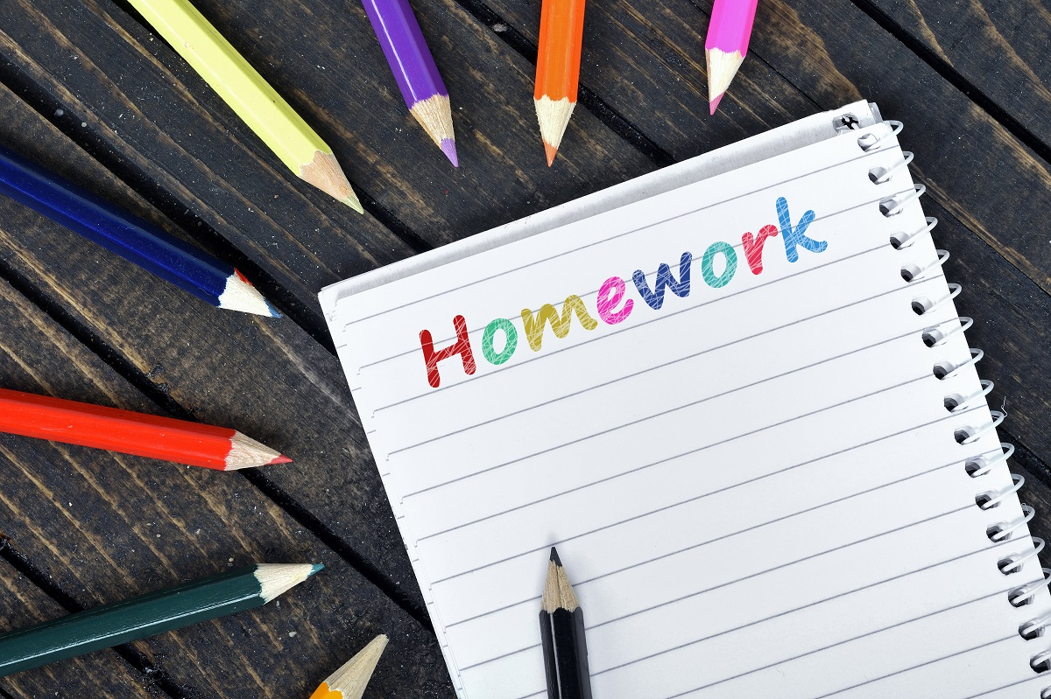
7th / 8th Grade Homework Club
Meetings:
Mondays - Room 220
Tuesdays - Room 213
Thursdays - Room 224

Slide 5
6th, 7th & 8th Grade Class Councils
Final Meeting
Thursday, May 1
Room 108

Slide 6
Intramural Sports Club
Tuesdays and Thursdays
After School - Gym
All students must have an up-to-date
sports physical and other required paperwork
approved before playing!

Slide 7
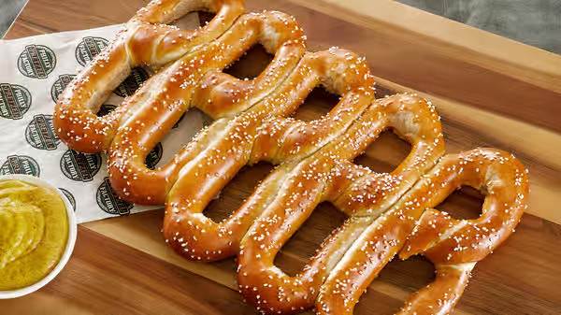
Pretzel Sale
Every Friday
On the way to your lunch period…
Room 121
$1.00
Spicy & Yellow Mustard Available

Slide 8
Today’s
Morning Announcements Team:
Liam Twaddell
Danny Greene

