Slide 1
Welcome Back!
Let’s make it a great year filled with lots of learning, lots of fun, and lots of reasons to make TWP proud!

Slide 2
Notes:
Talk about honoring the profession. Dress for success. Be on time. Beware of social media pitfalls. FERPA. School culture begins with each and every one of us.

Slide 3
Notes:
Birthday Intro

Slide 4
Notes:
Birthday Order

Slide 5
Notes:
Rock, Paper, Scissors Contest
*Remind them of the rule that you have to follow and cheer on the person that beats you!

Slide 6
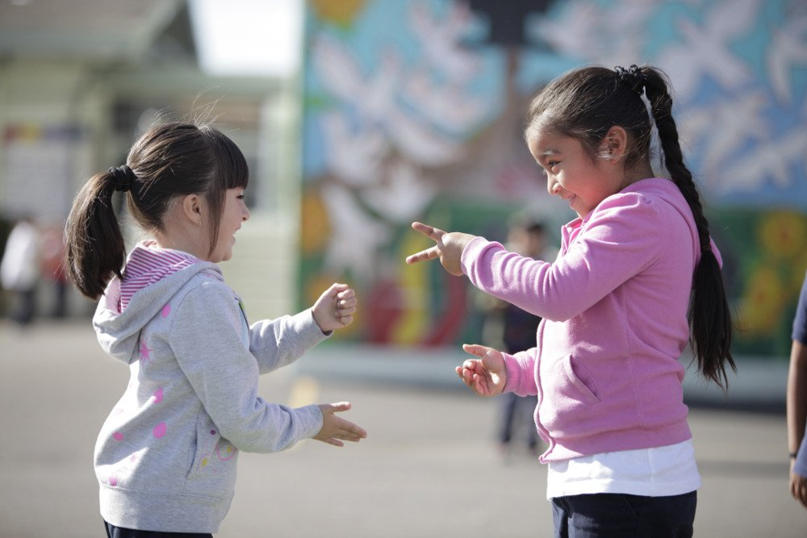
Notes:
Rock, Paper, Scissors Contest
*Remind them of the rule that you have to follow and cheer on the person that beats you!

Slide 7
Notes:
Brittany addresses the group….

Slide 8
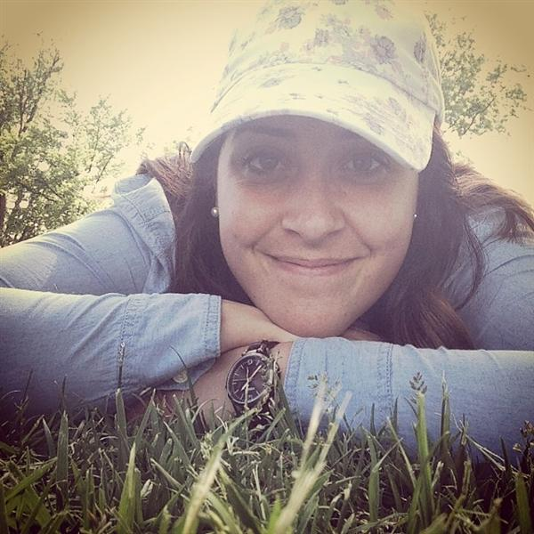
#BeMoreHuman
“Every day I attempt to create an environment in my classroom where students know that their circumstances are not definite, and they have an opportunity to do better,” Mason said. “My classroom has become a safe environment for many, a comfortable space where students come to share ideas, have conversations about life, and learn why social studies matters. Every lesson I teach, every resource I provide, and every interaction I have with my students is designed to provide them with meaningful opportunities to think outside the box, outside their community, even outside our nation and into the global arena. This is why I created the catch phrase ‘#BeMoreHuman.’ It is a tagline that I now use to highlight social justice lessons and acts of kindness and to remind my students that human interaction is the fundamental of life.”

Slide 9
Welcome to the High School Family
Support Staff
Donna Clarke – 11/12 Attendance Clerical Assistant
Ryan Francisco – 11/12 Specialized Instructional Assistant
Diana Gerace – 11/12 Attendance Clerical Assistant
Dana Johnson – Core Clerical Assistant
Anthony Piscielli – 9/10 Student Supervision Assistant
Kimberly Pompey – Core Clerical Assistant
Natasha Severino – 9/10 Health Assistant (Transfer from GTECC)
Justin Waller – Special Education Assistant (Transfer from BHMS)

Slide 10
Welcome to the High School Family
Teachers and Certificated Staff
Mary Abel – World Language (French)
Natalie Barretta – Math
Briana Baud – Counseling (Transfer from BHMS)
Liani Dillard – ESL (Transfer from GTECC)
Corinne Dowdell – Business (Transfer from CRMS)
Zachary Dzierzgowski – World Language (Spanish)
Staci Edmonds – English
Jessica Kelleher – Math
Jennifer Kraft – Special Education
Kathleen Luckiewicz – 11/12 Nurse (Transfer from OVMS)
Khadijah Muhammad-Kebe – Family & Consumer Science
Joshua Olive – Special Education
Michelle Snow – Special Education
Stephanie Taraschi – Health/Physical Education

Slide 11
Notes:
Intro New Teachers and Staff

Slide 12
CRITICAL INFORMATION
Notes:
Critical Information

Slide 13
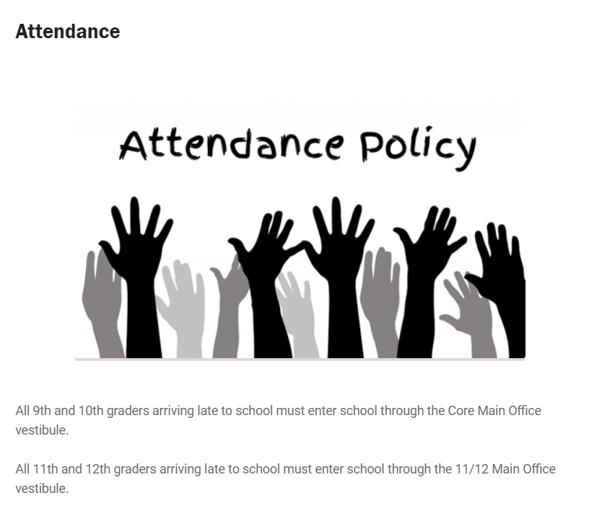

Slide 14
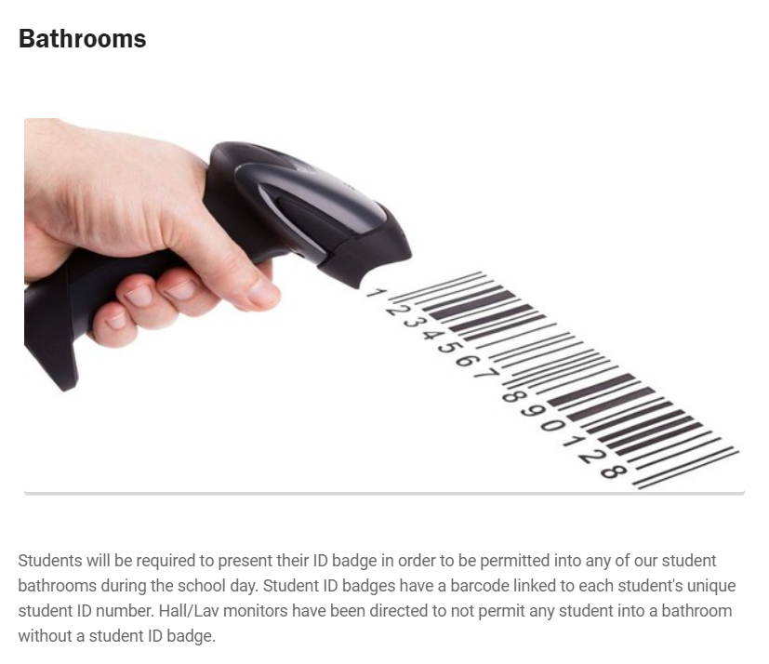

Slide 16
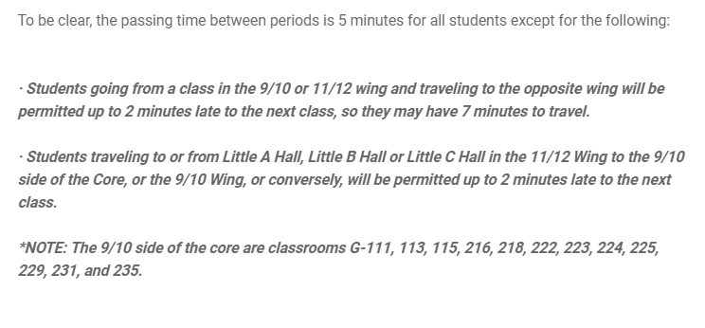

Slide 17
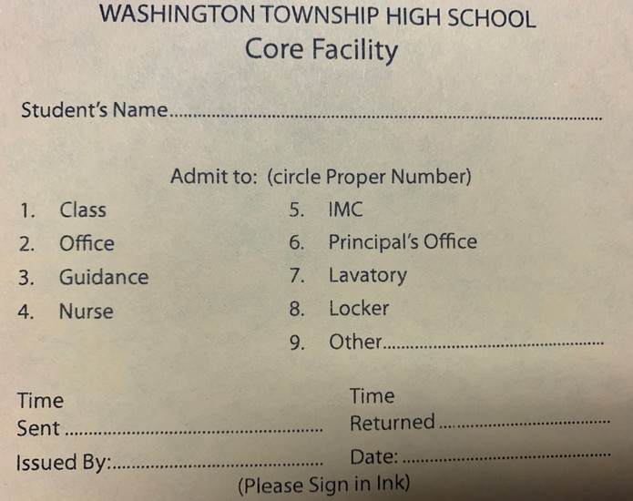
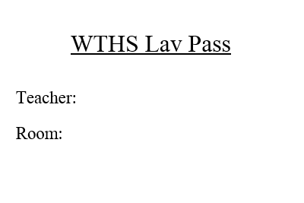
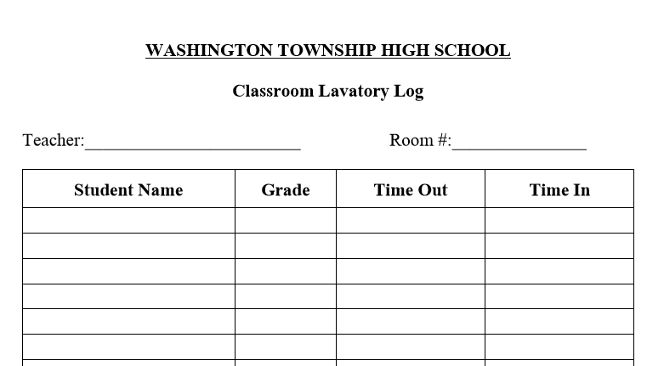

Slide 19
Child abuse of any kind
Suicide Ideation
Substance Abuse
HIB
Any matter considered imminent danger

Slide 20
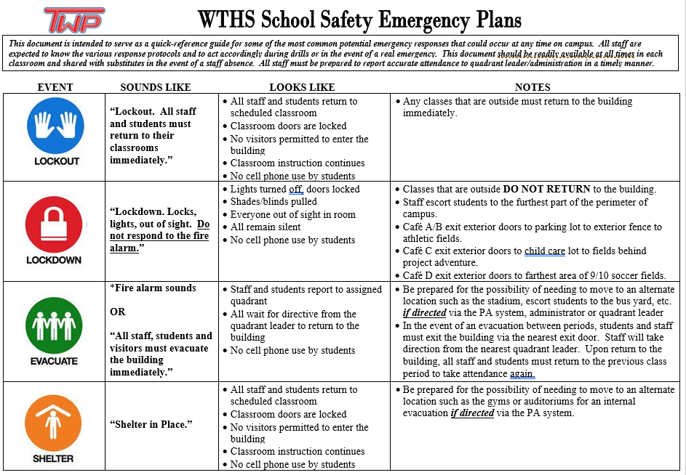
Notes:
Reminder of administrator in charge uses middle name to clear the drill…

Slide 26
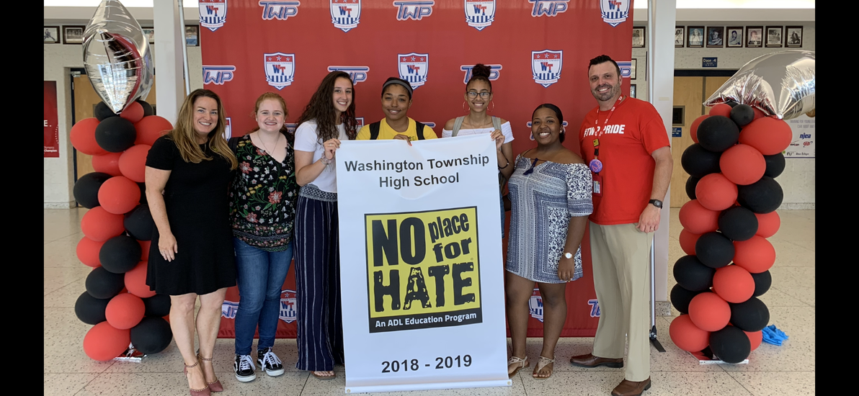

Slide 29
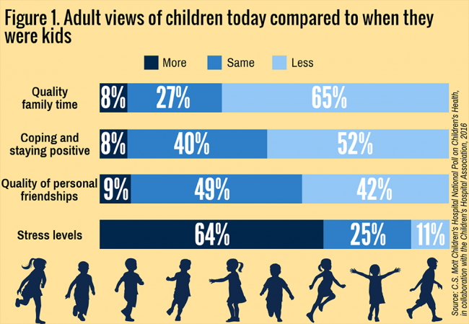

Slide 30
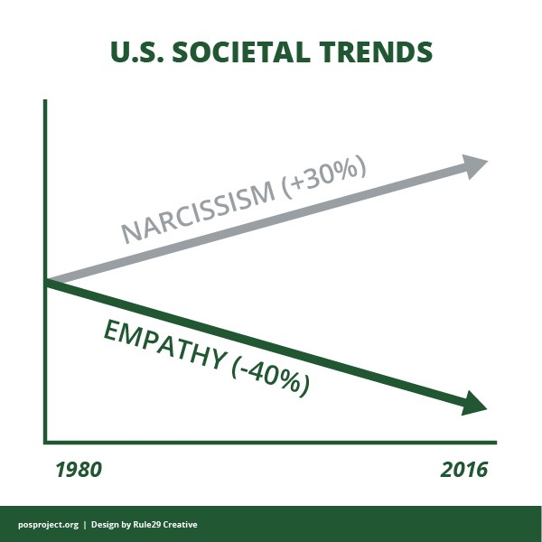

Slide 31
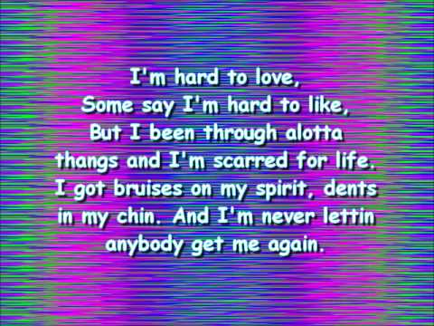

Slide 32
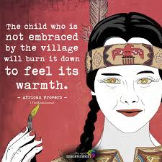

Slide 33
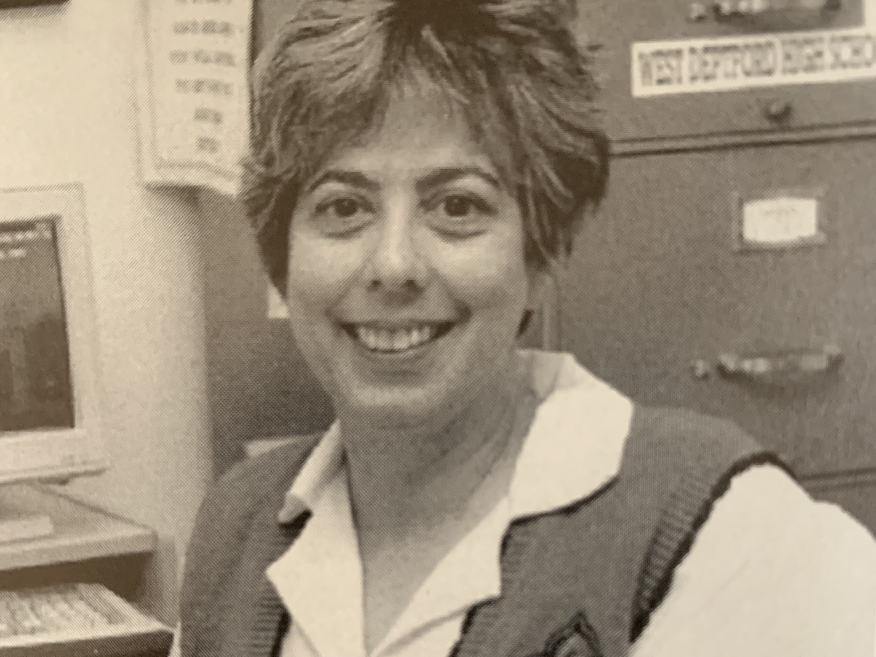

Slide 34
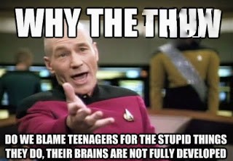

Slide 37
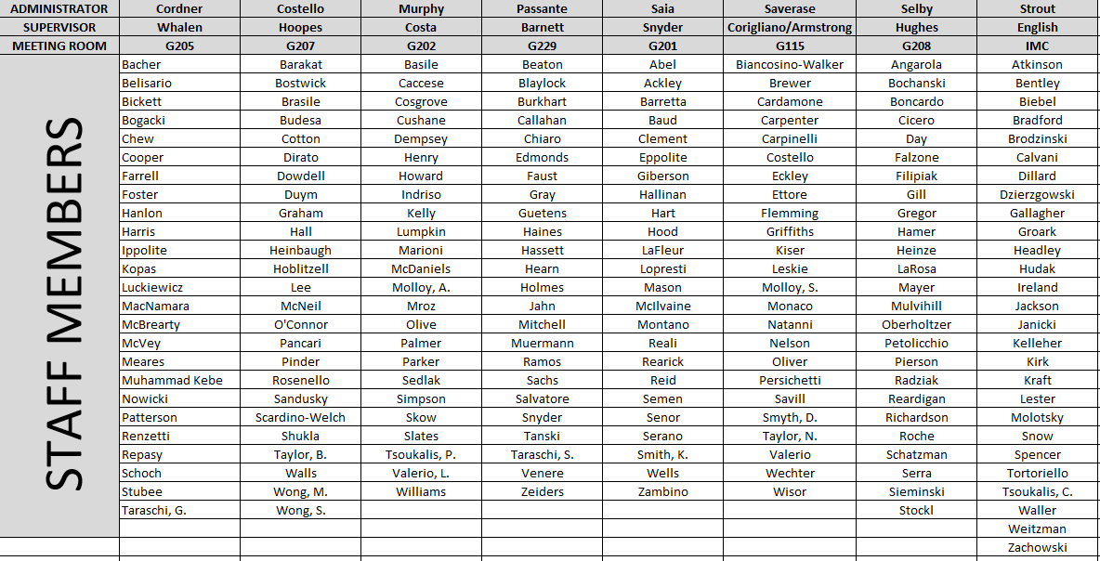
2019-2020 Faculty Cohorts

Slide 39
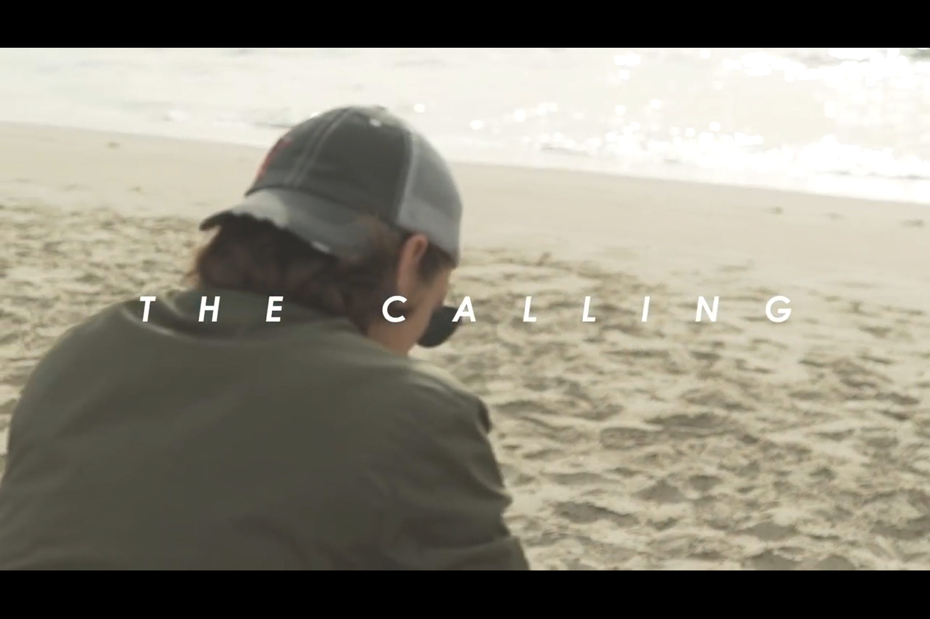

Slide 41
2019-2020 Faculty Cohorts

